Slide 1


Lab 1 Introduction

Slide 2

Socket programming

Slide 3

Client-Server communication
Server
Passively waits for and responds to clients
passive socket
Client
initiates the communication
must know the address and the port of the server
active socket

Slide 4
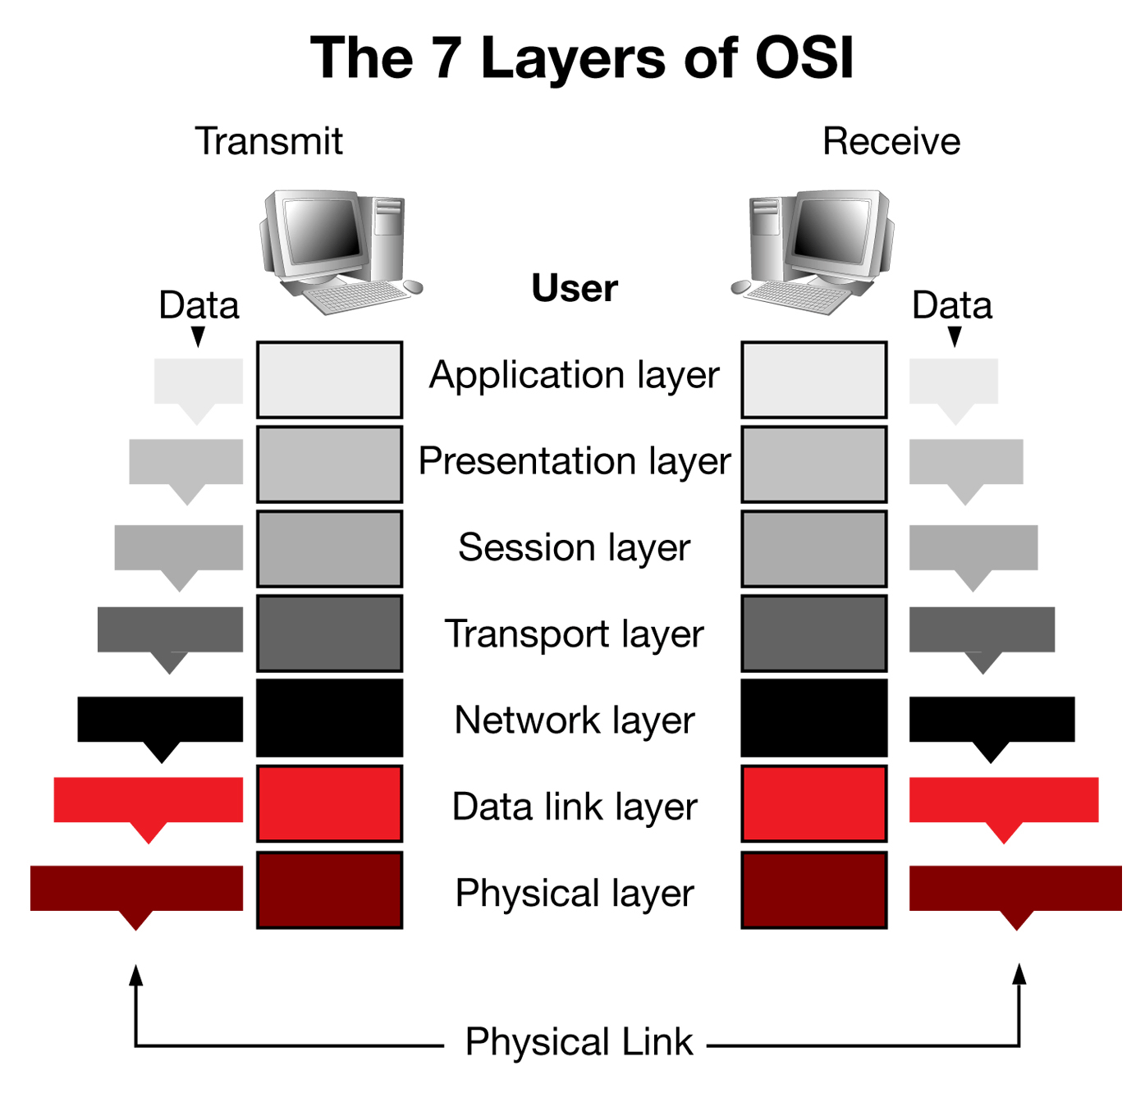
Socket in OSI 7 Layers
socket

Slide 5
TCP
Transmission Control Protocol
Reliable(Three-way handshake)
Retransmission
Deprecate duplicated packets
congestion control/ flow control

Slide 6
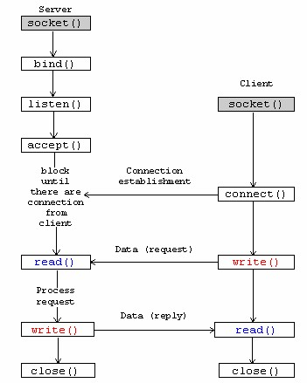
TCP flow
Establish socket
Bind address and socket
Listen for request
Accept request from client
Read socket
Write socket
Close socket

Slide 7
Function introduction
int socket(int domain, int type, int protocol) ;
domain : Specifies the communications domain in which a socket is to be created.
type : Specifies the type of socket to be created.
SOCK_STREAM: for TCP
SOCK_DGRAM: for UDP
protocol :Specifies a particular protocol to be used with the socket.
return value: nonnegative integer, the socket file descriptor.
Notes:
man socket

Slide 8
Function introduction (Server)
int bind(int socket, const struct sockaddr *address, socklen_t address_len);
The bind() function assigns an address to an unnamed socket.
socket : Specifies the file descriptor of the socket to be bound.
# Give it the return value of socket()
address: Points to a sockaddr structure containing the address to be bound to the socket.
address_len:
Specifies the length of the sockaddr structure pointed to by the address argument.
return value: successful return 0, otherwise return -1.
Notes:
man socket

Slide 9
Function introduction (Server)
int listen(int socket, int backlog);
socket : Specifies the file descriptor of the socket to be bound.
# Assign the return value of socket() to it
The listen() function marks a connection-mode socket, specified by the socket argument, as accepting connections, and limits the number of outstanding connections in the socket's listen queue to the value specified by the backlog argument.
return value: successful return 0, otherwise return -1.
Notes:
man socket

Slide 10
Function introduction (Server)
int accept (int socket, struct sockaddr *address, socklen_t *address_len);
socket : Specifies a socket that was created with socket(), has been bound to an address with bind(), and has issued a successful call to listen().
address: a pointer to a sockaddr structure where the address of the connecting socket will be returned.
address_len:output specifies the length of the stored address.
return value: Upon successful completion, accept() returns the nonnegative file descriptor of the accepted socket.
Notes:
man socket

Slide 11
Function introduction (Client)
int connect(int socket, const struct sockaddr *address, socklen_t address_len);
socket : Specifies the file descriptor associated with the socket.
address: Points to a sockaddr structure containing the peer address.
address_len:
Specifies the length of the sockaddr structure pointed to by the address argument.
return value: Upon successful completion, accept() returns the nonnegative file descriptor of the accepted socket.
Notes:
man socket

Slide 12
UDP
UDP (User Datagram Protocol)
Unreliable and more fast
No guarantee of transferring data bits or packets in an arranged manner(compare with TCP)

Slide 13
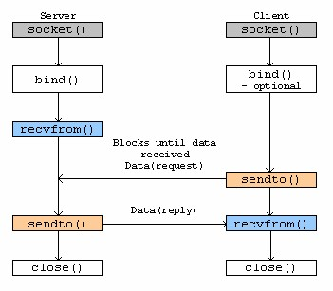
UDP Flow (connectionless)

Slide 14
Environment
Install Linux OS in a computer(VirtualBox or Vmware)
01
Using GCC for compiling
02
Using winsock for Windows Platform.
03

Slide 15
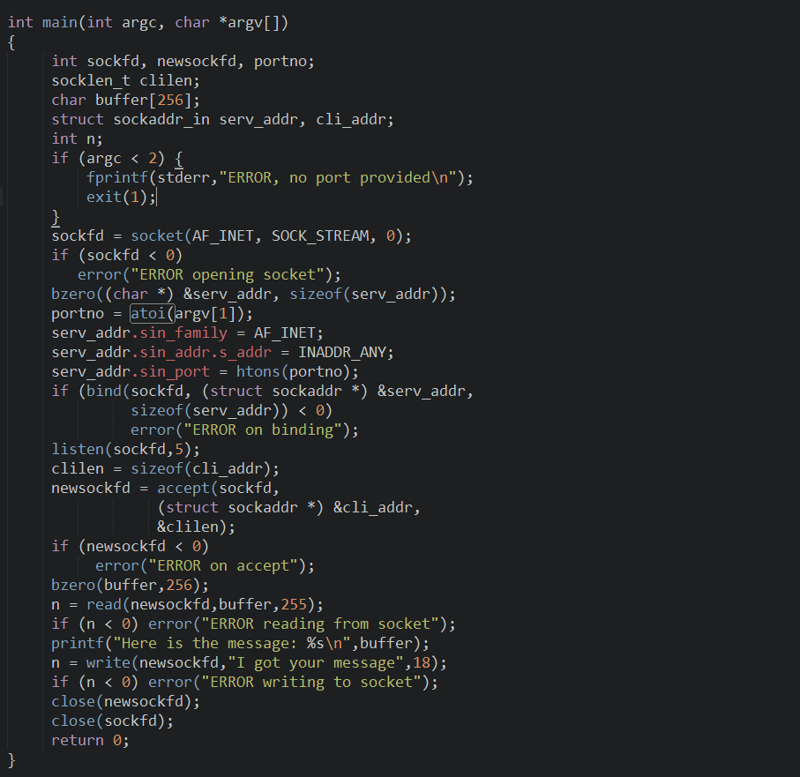
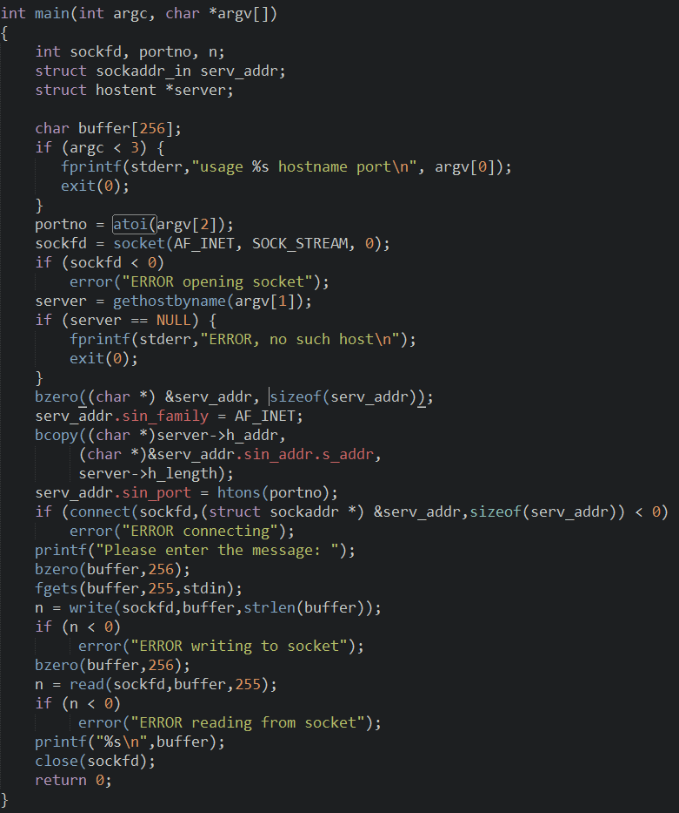
socket
socket
bind
connect
Listen & accept
write
read
read
write

Slide 16
TCP example
np/tcp/echo_once/server.c
gcc –o server server.c
./server.c 5566
np/tcp/echo_once/client.c
gcc –o client client.c
./client.c localhost 5566

Slide 17
UDP example
np/udp/echo/server.c
gcc –o server server.c
./server
np/udp/echo/client.c
gcc –o client client.c
./client

Slide 18
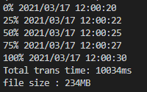
Lab 1 要求
分別使用 UDP 和 TCP 實現 File Transfer的功能
程式碼需附上註解
傳送之檔案需大於200MB
報告須包含以下記錄 (範例如下)
每傳送25% 記錄一筆log
總傳輸時間(ms)
檔案大小
UDP 需額外紀錄packet loss rate.
TCP example

Slide 19
輸入為以下形式 (以 linux 為例)
執行檔需有5個參數
依序為TCP或UDP, 傳送端或接收端, ip, port, 傳送檔案路徑
$ ./lab1_file_transfer tcp send <ip> <port> test_input.txt
$./lab1_file_transfer tcp recv <ip> <port>
$./lab1_file_transfer udp send <ip> <port> test_input.txt
$./lab1_file_transfer udp recv <ip> <port>

Slide 20
Lab1作業繳交資訊
Moodle 上傳作業
報告請用ppt檔，code請用.c或.cpp檔，需要上傳檔案(1)ppt (2)code
將檔案壓縮, 檔名用自己的學號加上編號命名
例如: P76031292_lab1.zip
DUE : 2021. 3. 30 .23:59
可參考網路上 socket 讀寫檔
若檔案繳交不完整，將會斟酌扣分

Slide 21
reference
https://pubs.opengroup.org/onlinepubs/7908799/xns/socket.html
https://www.itread01.com/p/1380962.html
https://www.csd.uoc.gr/~hy556/material/tutorials/cs556-3rd-tutorial.pdf

